Slide 1
Components of DBMS
The database management system can be divided into five major components, they are:
1. Hardware
2. Software
3. Data
4. Procedures
5. Database Access Language

Slide 2
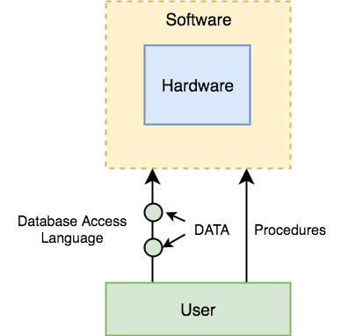

Slide 3
DBMS Components: Hardware
When we say Hardware, we mean computer, hard disks, I/O channels for data, and any other physical component involved before any data is successfully stored into the memory.
When we run Oracle or MySQL on our personal computer, then our computer's Hard Disk, our Keyboard using which we type in all the commands, our computer's RAM, ROM all become a part of the DBMS hardware.

Slide 4
DBMS Components: Software
This is the main component, as this is the program which controls everything. The DBMS software is more like a wrapper around the physical database, which provides us with an easy-to-use interface to store, access and update data.
The DBMS software is capable of understanding the Database Access Language and interpret it into actual database commands to execute them on the DB.

Slide 5
DBMS Components: Data
Data is that resource, for which DBMS was designed. The motive behind the creation of DBMS was to store and utilize data.
In a typical Database, the user saved Data is present and meta data is stored.
Metadata is data about the data. This is information stored by the DBMS to better understand the data stored in it.
For example: When I store my Name in a database, the DBMS will store when the name was stored in the database, what is the size of the name, is it stored as related data to some other data, or is it independent, all this information is metadata.

Slide 6
DBMS Components: Procedures
Procedures refer to general instructions to use a database management system. This includes procedures to setup and install a DBMS, To login and logout of DBMS software, to manage databases, to take backups, generating reports etc.

Slide 7
DBMS Components: Database Access Language
Database Access Language is a simple language designed to write commands to access, insert, update and delete data stored in any database.
A user can write commands in the Database Access Language and submit it to the DBMS for execution, which is then translated and executed by the DBMS.

Slide 8
DBMS Architecture
The DBMS design depends upon its architecture. The basic client/server architecture is used to deal with a large number of PCs, web servers, database servers and other components that are connected with networks.
The client/server architecture consists of many PCs and a workstation which are connected via the network.
DBMS architecture depends upon how users are connected to the database to get their request done.

Slide 9
Types of DBMS Architecture

Slide 10
1-Tier Architecture
In this architecture, the database is directly available to the user. It means the user can directly sit on the DBMS and uses it.
Any changes done here will directly be done on the database itself. It doesn't provide a handy tool for end users.
The 1-Tier architecture is used for development of the local application, where programmers can directly communicate with the database for the quick response.

Slide 11
2-Tier Architecture
The 2-Tier architecture is same as basic client-server. In the two-tier architecture, applications on the client end can directly communicate with the database at the server side. For this interaction, API's like: ODBC, JDBC are used.
The user interfaces and application programs are run on the client-side.
The server side is responsible to provide the functionalities like: query processing and transaction management.
To communicate with the DBMS, client-side application establishes a connection with the server side.

Slide 12
Fig: 2-tier Architecture

Slide 13
3-Tier Architecture
The 3-Tier architecture contains another layer between the client and server. In this architecture, client can't directly communicate with the server.
The application on the client-end interacts with an application server which further communicates with the database system.
End user has no idea about the existence of the database beyond the application server. The database also has no idea about any other user beyond the application.
The 3-Tier architecture is used in case of large web application.

Slide 14
Fig: 3-tier Architecture

Slide 15
Data Abstraction in DBMS
Database systems are made-up of complex data structures. To ease the user interaction with database, the developers hide internal irrelevant details from users. This process of hiding irrelevant details from user is called data abstraction.

Slide 16
We have three levels of abstraction:
Physical level: This is the lowest level of data abstraction. It describes how data is actually stored in database. You can get the complex data structure details at this level.
Logical level: This is the middle level of 3-level data abstraction architecture. It describes what data is stored in database.
View level: Highest level of data abstraction. This level describes the user interaction with database system.

Slide 17
Database Schema
A database schema is the skeleton structure that represents the logical view of the entire database. It defines how the data is organized and how the relations among them are associated. It formulates all the constraints that are to be applied on the data.
A database schema defines its entities and the relationship among them. It contains a descriptive detail of the database, which can be depicted by means of schema diagrams. It’s the database designers who design the schema to help programmers understand the database and make it useful.

Slide 18
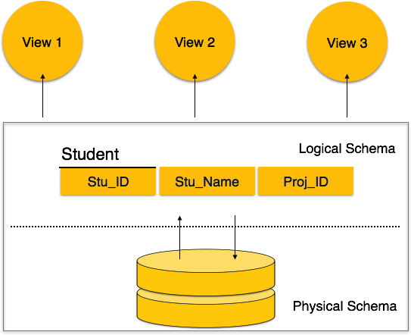

Slide 19
A database schema can be divided broadly into two categories −
Physical Database Schema − This schema pertains to the actual storage of data and its form of storage like files, indices, etc. It defines how the data will be stored in a secondary storage.
Logical Database Schema − This schema defines all the logical constraints that need to be applied on the data stored. It defines tables, views, and integrity constraints.

Slide 20
Database Instance
It is important that we distinguish these two terms individually. Database schema is the skeleton of database. It is designed when the database doesn't exist at all. Once the database is operational, it is very difficult to make any changes to it.
A database schema does not contain any data or information.
A database instance is a state of operational database with data at any given time. It contains a snapshot of the database.
Database instances tend to change with time.
A DBMS ensures that its every instance (state) is in a valid state, by diligently following all the validations, constraints, and conditions that the database designers have imposed.

Slide 21
THANK YOU

